Slide 1
BMI Status Analysis with Excel
Jason Zheng

Slide 2
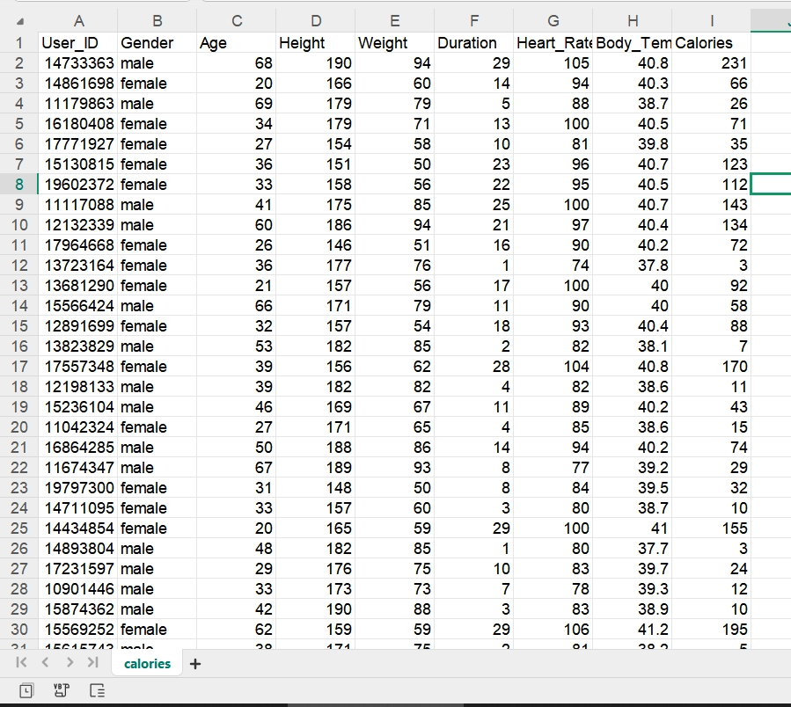
Data Cleansing
Raw Data

Slide 3
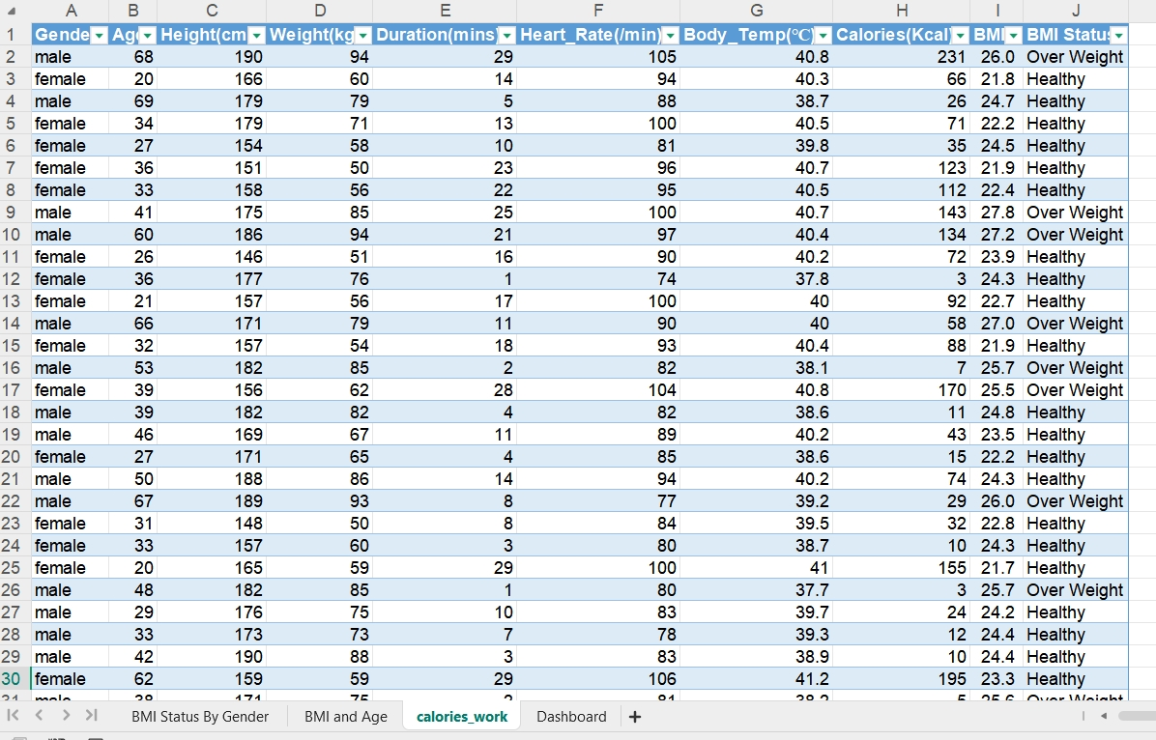
Data Processed
BMI is calculated as Weight(kg)/Height(cm)^2.
BMI are catergorized as three categories.
Underweight: BMI<19
Healthy: 19<=BMI<25
Overweight: BMI>25

Slide 4
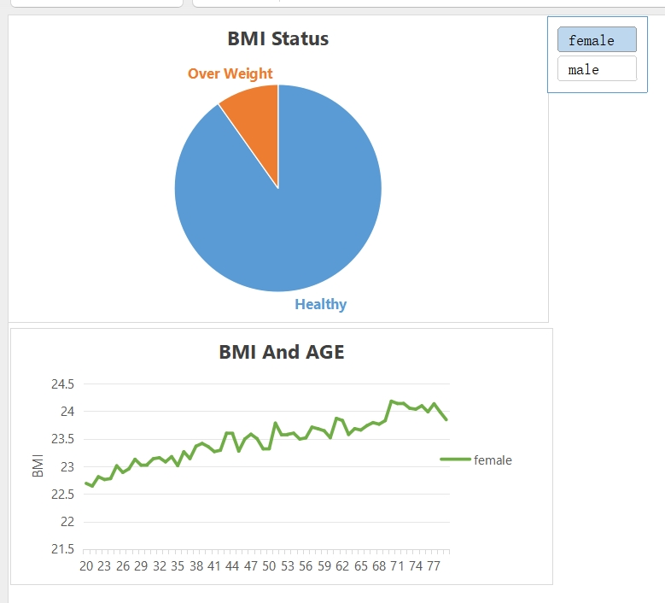
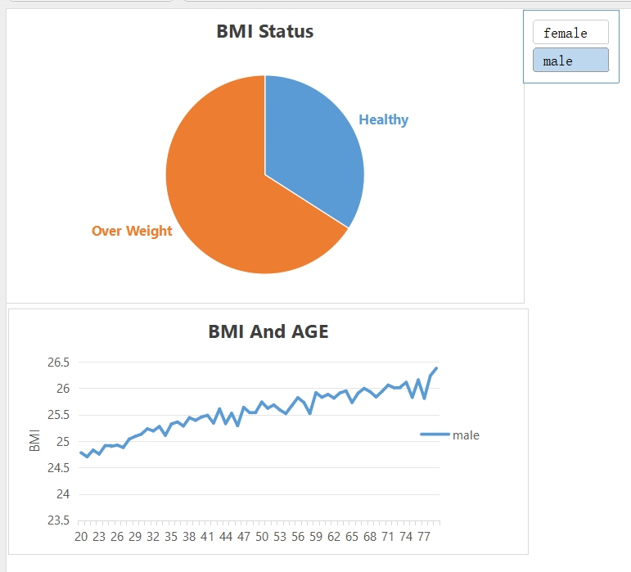
Data Visualisation
BMI Status of Female
BMI Status of Male

Slide 5
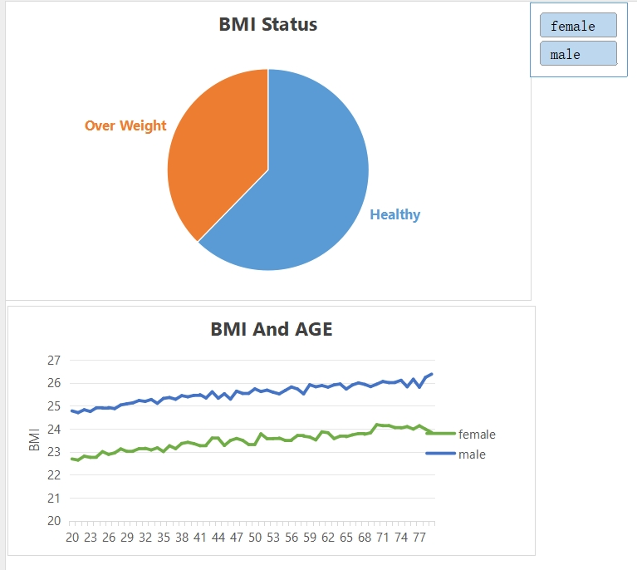
BMI Status for all
Majority BMI are healthy.
BMI increases with age.
Over half of males are overweight.

